Slide 1
Chapter 8
Classification: Basic Concept
Ôn Đông Hải - ITITIU14025
Tô Hoàng Hải – ITITIU14026

Slide 2
Content
8.1 Basic Concept
8.2 Decision Tree Induction
8.3 Bayes Classification Methods
8.4 Rule-based Classification
8.5 Model Evaluation and Selection
8.6 Techniques to improve Classification Accuracy

Slide 3
8.1 Basic Concept
8.1.1 What is Classification?
A form of data analysis that extracts models describing important data classes.
Predict categorical (discrete, unordered) class labels.
Numerous applications, including fraud detection, target marketing, performance prediction, manufacturing, and medical diagnosis.

Slide 4
Example
- A bank loans ofﬁcer needs analysis of her data to learn which loan applicants are “safe” and which are “risky” for the bank.
- A marketing manager at AllElectronics needs data analysis to help guess whether a customer with a given proﬁle will buy a new computer.
➔ The data analysis task is classiﬁcation, where a model or classiﬁer is constructed to predict class (categorical) labels, such as “safe” or “risky” for the loan application data; “yes” or “no” for the marketing data;

Slide 5
8.1.2 General Approach to Classification
Data classiﬁcation is a two-step process, consisting of:
➢ Learning step, where a classiﬁcation model is constructed.
➢ Classiﬁcation step, where the model is used to predict class labels for given data.

Slide 6
In the learning step (or training phase)
➢ A classiﬁer is built describing a predetermined set of data classes or concepts.
➢ By analyzing or “learning from” a training set, a classiﬁcation algorithm builds the classiﬁer.
• A tuple, X, is represented by an n-dimensional attribute vector, from n database attributes.
• Each tuple, X, is assumed to belong to a predeﬁned class as determined by another database attribute called the class label attribute.
• The class label attribute is discrete-valued and unordered.

Slide 7
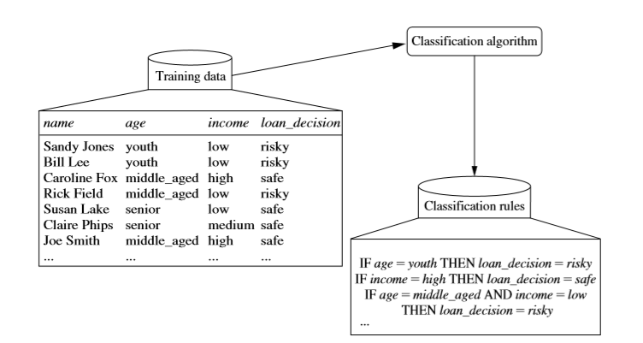
Figure 8.1a
Learning Step: Here, the class label attribute is loan_decision, and the learned model or classiﬁer is represented in the form of classiﬁcation rules.

Slide 8
In the classification step:
➢ The model is used for classiﬁcation.
➢ The predictive accuracy of the classiﬁer is estimated.
➢ A test set is used, made up of test tuples and their associated class labels.
➢ The accuracy of a classiﬁer on a given test set is the percentage of test set tuples that are correctly classiﬁed by the classiﬁer.
➢ If the accuracy is considered acceptable, the classiﬁer can be used to classify future data tuples for which the class label is not known.

Slide 9
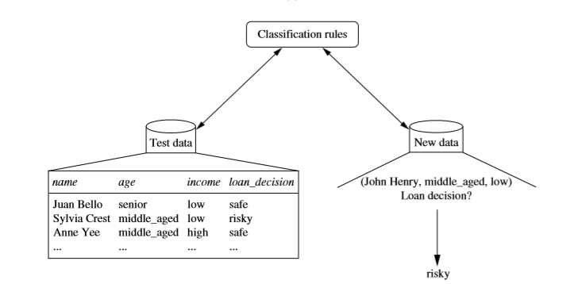
Figure 8.1b
Classiﬁcation: Test data are used to estimate the accuracy of the classiﬁcation rules. If the accuracy is considered acceptable, the rules can be applied to the classiﬁcation of new data tuples.

Slide 10
8.2.1 Decicsion Tree Induction
History
• During the late 1970s and early 1980s, J. Ross Quinlan, a researcher in machine learning, developed a decision tree algorithm known as ID3 (Iterative Dichotomiser).
• Quinlan later presented C4.5 (a successor of ID3), which became a benchmark to which newer supervised learning algorithms are often compared.
• In 1984, a group of statisticians (L. Breiman, J. Friedman, R. Olshen, and C. Stone) published the book Classiﬁcation and Regression Trees (CART), which described the generation of binary decision trees.

Slide 11
What is Decision tree induction?
➢ The learning of decision trees from class-labeled training tuples.
➢ A ﬂowchart-like tree structure, where
• Each internal node (nonleaf node) denotes a test on an attribute, denoted by rectangles.
• Each branch represents an outcome of the test
• Each leaf node (or terminal node) holds a class label, denoted by ovals.
• The topmost node in a tree is the root node.

Slide 12
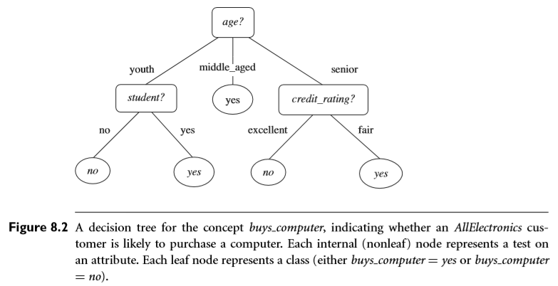

Slide 13
“How are decision trees used for classiﬁcation?”
➢ A tuple, X, for which the associated class label is unknown, has its attribute values tested against the decision tree. A path is traced from the root to a leaf node, which holds the class prediction for that tuple.
“Why are decision tree classiﬁers so popular?”
• Does not require any domain knowledge or parameter setting, and therefore is appropriate for exploratory knowledge discovery.
• Can handle multidimensional data.
• The learning and classiﬁcation steps are simple and fast.
• Decision tree classiﬁers have good accuracy.
• Used for classiﬁcation in many application areas such as medicine, manufacturing and production, ﬁnancial analysis, astronomy, and molecular biology. Decision trees are the basis of several commercial rule induction systems.

Slide 14
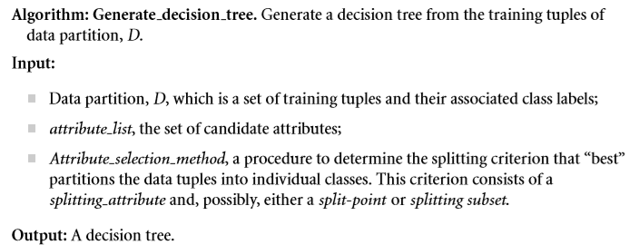

Slide 15
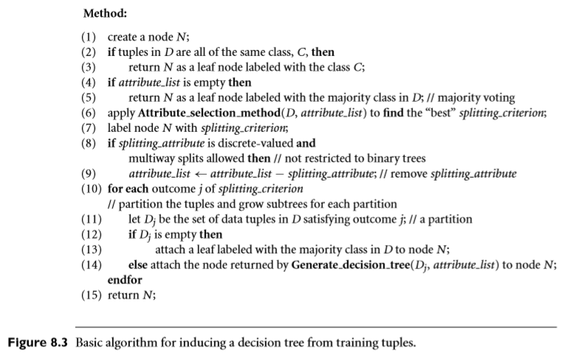

Slide 16
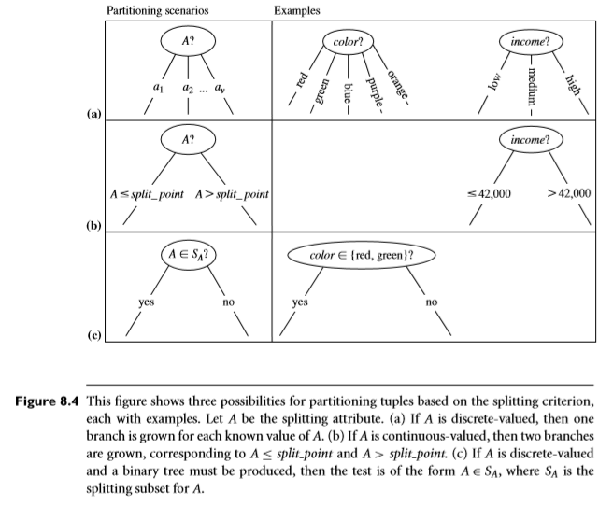

Slide 17
8.2.2 Attribute Selection Measures
➢ Is a heuristic for selecting the splitting criterion that “best”separates a given data partition, D,of class-labeled training tuples into individual classes.
➢ Also known as splitting rules because they determine how the tuples at a given node are to be split.
➢ Provides a ranking for each attribute describing the given training tuples. The attribute having the best score for the measure is chosen as the splitting attribute for the given tuples.

Slide 18

** Information Gain
➢ ID3 uses information gain as its attribute selection measure.
➢ The attribute with the highest information gain is chosen as the splitting attribute for node N. This attribute minimizes the information needed to classify the tuples in the
resulting partitions and reﬂects the least randomness or “impurity” in these partitions.
• The expected information needed to classify a tuple in D is given by
p_{i} is the nonzero probability that an arbitrary tuple in D belongs to class Ci and is estimated by|Ci,D|/|D|.

Slide 19
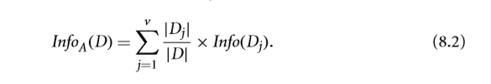

• After the partitioning, we still need more information to arrive at an exact classiﬁcation. This amount is measured by
Info_{A}(D) is the expected information required to classify a tuple from D based on the partitioning by A.
• Information gain is deﬁned as the difference between the original information requirement(i.e.,based on just the proportion of classes) and the new requirement (i.e., obtained after partitioning on A). That is,
The attribute A with the highest information gain, Gain(A), is chosen as the splitting attribute at node N.

Slide 20
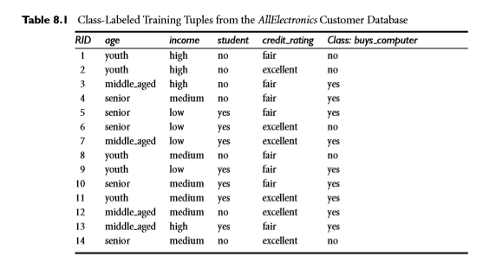
Example of Information Gain

Slide 21


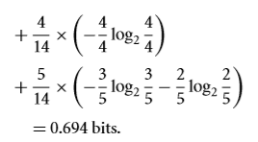
• The class label attribute, buys_computer, has two distinct values {yes, no} ➔m=2.
9 tuples of class yes and ﬁve tuples of class no.
• We ﬁrst use Eq. (8.1) to compute the expected information needed to classify a tuple in D:
• For the age category “youth,” there are two yes tuples and three no tuples. For the category “middle aged,” there are four yes tuples and zero no tuples. For the category “senior,” there are three yes tuples and two no tuples.
• Using Eq. (8.2), the expected information needed to classify a tuple in D if the tuples are partitioned according to age is

Slide 22
• Hence, the gain in information from such a partitioning would be
• Similarly, we can compute
Gain(income) = 0.029 bits
Gain(student)=0.151 bits
and Gain(credit rating)=0.048 bits.

Slide 23
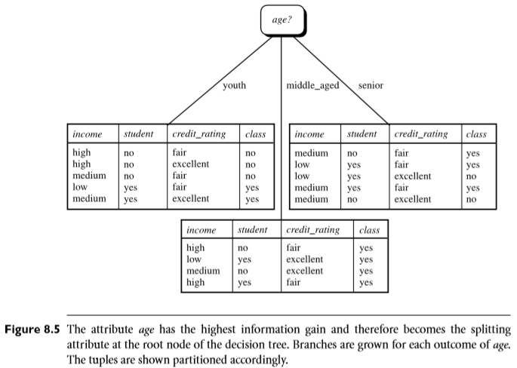

Slide 24


** Gain Ratio
➢ C4.5, a successor of ID3, uses an extension to information gain known as gain ratio.
• Applies a kind of normalization to information gain using a “split information” value deﬁned analogously with Info(D) as
This value represents the potential information generated by splitting the training data set, D, into v partitions, corresponding to the v outcomes of a test on attribute A.
• The gain ratio is deﬁned as
The attribute with the maximum gain ratio is selected as the splitting attribute.

Slide 25
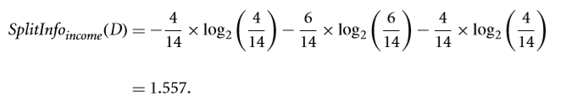
Example of Gain Ratio
• A test on income splits the data of Table 8.1 into three partitions, namely low, medium, and high, containing four, six, and four tuples, respectively. To compute the gain ratio of income, we ﬁrst use Eq. (8.5) to obtain
From Example 8.1, we have Gain(income) = 0.029. Therefore,
GainRatio(income) = 0.029/1.557 = 0.019

Slide 26


**Gini Index
➢ The Gini index is used in CART.
➢ The Gini index measures the impurity of D, a data partition or set of training tuples, as
where p_{i} is the probability that a tuple in D belongs to class C_{i} and is estimated by |C_{i} , D|/|D|. The sum is computed over m classes.
➢ The Gini index considers a binary split for each attribute.
➢ Examine all the possible subsets of known values of A. Each subset, S_{A}, can be considered as a binary test for attribute A of the from “A ∈ S_{A}?”
➢ If a binary split on A partitions D into D₁ and D₂, the Gini index of D given that partitioning is

Slide 27

➢ The reduction in impurity that would be incurred by a binary split on a discrete- or continuous-valued attribute A is
➢ The attribute that maximizes the reduction in impurity (or, equivalently, has the minimum Gini index) is selected as the splitting attribute.

Slide 28

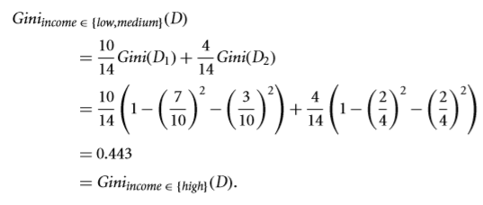
Example of Gini Index
➢ In Table 8.1, there are nine tuples in the class buys_computer= yes and the remaining ﬁve tuples belong to the class buys computer=no. Use Eq. (8.7) for the Gini index to compute the impurity of D:
➢To ﬁnd the splitting criterion for the tuples in D, we need to compute the Gini index for each attribute.
➢ Start with the attribute income.Consider the subset {low, medium}. This would result in 10 tuples in partition D1 satisfying the condition “income ∈ {low, medium}”. The remaining 4 tuples of D would be assigned to partition D2. The Gini index value computed based on this partitioning is:

Slide 29
➢ Similarly, the Gini index values for splits on the remaining subsets are
0.458 (forthesubsets {low, high} and {medium})
and 0.450 (for the subsets {medium, high} and {low}).
→ The best binary split for attribute income is on {low, medium} (or {high}) because it minimizes the Gini index.
➢ Evaluating age, we obtain {youth, senior} (or {middle aged}) as the best split for age with a Gini index of 0.375; the attributes student and credit rating are both binary, with Gini index values of 0.367 and 0.429, respectively.
The attribute age and splitting subset {youth, senior} therefore give the minimum Gini index overall, with a reduction in impurity of 0.459−0.357=0.102.
The binary split “age∈{youth,senior?}” results in the maximum reduction in impurity of the tuples in D and is returned as the splitting criterion.

Slide 30
**Other Attribute Selection Measures
• CHAID, a decision tree algorithm that is popular in marketing, uses an attribute selection measure that is based on the statistical χ2 test for independence.
• C-SEP (which performs better than information gain and the Gini index in certain cases)
• G-statistic (an information theoretic measure that is a close approximation to χ2 distribution).
Attribute selection measures based on the Minimum Description Length (MDL) principle have the least bias toward multivalued attributes. MDL-based measures use encoding techniques to deﬁne the “best” decision tree.

Slide 31
8.2.3 Tree Pruning
• In a decision tree, many of the branches will reﬂect anomalies in the training data due to noise or outliers.
→ Problem of overﬁtting the data.
→ Tree pruning typically use statistical measures to remove the least-reliable branches.
• Pruned trees tend to be smaller and less complex and, thus, easier to comprehend.
• Usually faster and better at correctly classifying independent test data (i.e., of previously unseen tuples) than unpruned trees.
• Two common approaches to tree pruning: prepruning and postpruning.

Slide 32
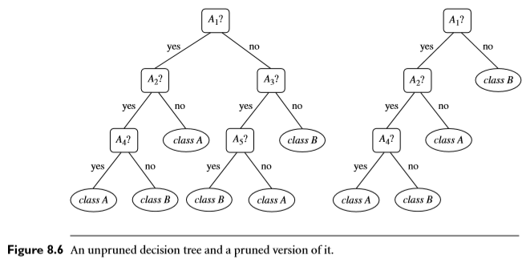

Slide 33
Prepruning Approach
A tree is “pruned” by halting its construction early (e.g., by deciding not to further split or partition the subset of training tuples at a given node).
➢ Upon halting, the node becomes a leaf. The leaf may hold the most frequent class among the subset tuples or the probability distribution of those tuples.

Slide 34
Postpruning Approach
More common approach than prepruning.
Removes subtrees from a “fully grown” tree.
A subtree at a given node is pruned by removing its branches and replacing it with a leaf. The leaf is labeled with the most frequent class among the subtree being replaced.
For example, notice the subtree at node “A3?” in the unpruned tree of Figure 8.6. Suppose that the most common class within this subtree is “class B.” In the pruned version of the tree, the subtree in question is pruned by replacing it with the leaf “class B.”

Slide 35
The cost complexity pruning algorithm used in CART is an example of the post pruning approach.
A pruning set of class-labeled tuples is used to estimate cost complexity.
Starts from the bottom of the tree, for each internal node, N, it computes the cost complexity of the subtree at N, and the cost complexity of the subtree at N if it were to be pruned (i.e., replaced by a leaf node).
The two values are compared. If pruning the subtree at node N would result in a smaller cost complexity, then the subtree is pruned. Otherwise, it is kept.

Slide 36
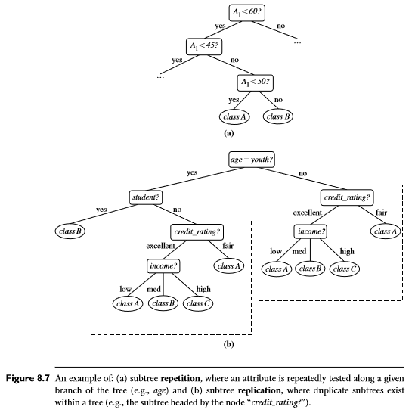
Decision trees can suffer from repetition and replication (Figure8.7), making them overwhelming to interpret.

Slide 37
8.2.4 Scalability and Decision Tree Induction
Very large training sets of millions of tuples are common.
→More scalable approaches, capable of handling training data that are too large to ﬁt in memory, are required.
RainForest: adapts to the amount of main memory available and applies to any decision tree induction algorithm. The method maintains an AVC-set (where “AVC” stands for “Attribute-Value, Classlabel”) for each attribute, at each tree node, describing the training tuples at the node.
BOAT (Bootstrapped Optimistic Algorithm for Tree construction) is a decision tree algorithm that takes a completely different approach to scalability. It uses a statistical technique known as “bootstrapping” (Section 8.5.4) to create several smaller samples (or subsets) of the given training data, each of which ﬁts in memory.

Slide 38
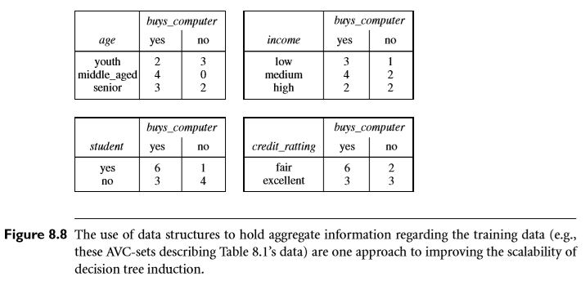

Slide 39
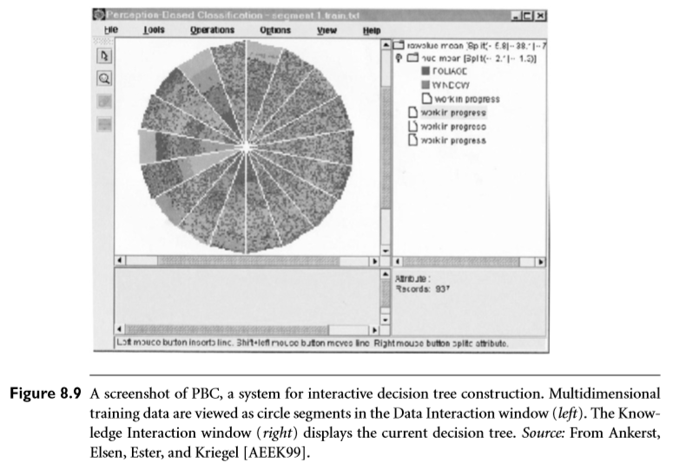
8.2.5 Visual Mining for Decision Tree Induction
Perception-based classiﬁcation (PBC) is an interactive approach based on multidimensional visualization techniques and allows the user to incorporate background knowledge about the data when building a decision tree.

Slide 40
8.3 Bayes Classification Methods
8.3.1 Bayes’ Theorem
Bayes’ theorem is named after Thomas Bayes, a nonconformist English clergyman who did early work in probability and decision theory during the 18th century.
In Bayesian terms, X, a data tuple, is considered “evidence.”
Let H be some hypothesis such as that the data tuple X belongs to a speciﬁed class C.
We want to determine P(H|X), the probability that tuple X belongs to class C, given that we know the attribute description of X.
P(H|X) is the posterior probability, or a posteriori probability, of H conditioned on X.

Slide 41
Example: suppose our data tuples is conﬁned to customers described by the attributes age and income, respectively, and that X is a 35-year-old customer with an income of $40,000. Suppose that H is the hypothesis that our customer will buy a computer.
→Then P(H|X) reﬂects the probability that customer X will buy a computer given that we know the customer’s age and income.
→ P(H) is the prior probability, or a priori probability, of H.This is the probability that any given customer will buy a computer, regardless of age, income, or any other information, for that matter.
→ Similarly, P(X|H) is the posterior probability of X conditioned on H. It is the probability that a customer, X, is 35 years old and earns $40,000, given that we know the customer will buy a computer.
→ P(X) is the prior probability of X. It is the probability that a person from our set of customers is 35 years old and earns $40,000.

Slide 42

Bayes’ theorem provides a way of calculating the posterior probability, P(H|X), that is

Slide 43


The na¨ıve Bayesian classiﬁer, or simple Bayesian classiﬁer, works as follows:
1. D as a training set of tuples and their associated class labels.
2. Suppose that there are m classes, C₁, C₂,..., C_{m}. The na¨ıve Bayesian classiﬁer predicts that tuple X belongs to the class C­_{­i} if and only if
3. As P(X) is constant for all classes, only P(X| C_{i} )P(C_{i} ) needs to be maximized. If the class prior probabilities are not known, then it is commonly assumed that the classes are equally likely, that is, P(C1)=P(C2)=···=P(Cm)
→therefore maximize P(X|Ci).
The class prior probabilities may be estimated by P(Ci)=|C_{i,D}|/|D|, where |C_{i,D}|is the number of training tuples of class C_{i} in D.

Slide 44
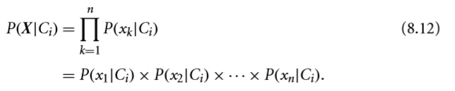
4. Given data sets with many attributes, it would be extremely computationally expensive to compute P(X|Ci). To reduce computation in evaluating P(X|Ci), the na¨ıve assumption of class-conditional independence is made.
To compute P(X|C_{i}), we consider the following:
(a) If A_{k} is categorical, then P(x_{k}|C_{i}) is the number of tuples of class C_{i} in D having the value x_{k} for A_{k}, divided by|C_{i,D}|, the number of tuples of class C_{i} in D.

Slide 45
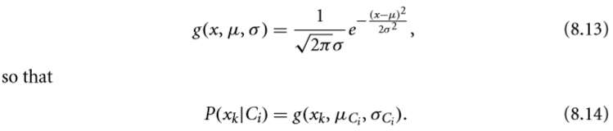
(b) If A_{k} is continuous-valued, then it is typically assumed to have a Gaussian distribution with a mean μ and standard deviation σ, deﬁned by
We need to compute μ_{Ci} and σ_{Ci}, which are the mean (i.e., average) and standard deviation, respectively, of the values of attribute A_{k} for training tuples of class C_{i}.We then plug these two quantities into Eq. (8.13), together with x_{k}, to estimate P(x_{k}|C_{i}).

Slide 46
5. To predict the class label of X, P(X|C_{i})P(C_{i}) is evaluated for each class C_{i}. The classiﬁer predicts that the class label of tuple X is the class C_{i} if and only if
→ In theory, Bayesian classiﬁers have the minimum error rate in comparison to all other classiﬁers. However, in practice this is not always the case, owing to inaccuracies in the assumptions made for its use, such as class-conditional independence, and the lack of available probability data.

Slide 47
Example
Predicting a class label using na¨ıve Bayesian classiﬁcation. We wish to predict the class label of a tuple using na¨ıve Bayesian classiﬁcation, given the same training data as in Example 8.3 for decision tree induction. The training data were shown earlier in Table 8.1. The data tuples are described by the attributes age, income, student, and credit rating. The class label attribute, buys_computer, has two distinct values (namely, {yes, no}). Let C1 correspond to the class buys_computer = yes and C2 correspond to buys_computer=no.

Slide 48
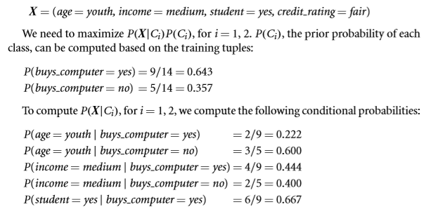

→ The tuple we wish to classify is

Slide 49
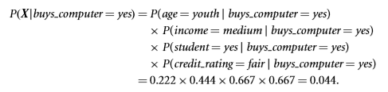
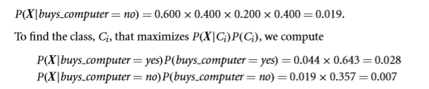
Using these probabilities, we obtain
Similarly,
→ Therefore, the na¨ıve Bayesian classiﬁer predicts buys_computer=yes for tuple X.

Slide 50
8.4 Rule-Based Classiﬁcation
In this section, we look at rule-based classiﬁers, where the learned model is represented as a set of IF-THEN rules.

Slide 51


8.4.1 Using IF-THEN Rules for Classiﬁcation
• A rule-based classiﬁer uses a set of IF-THEN rules for classiﬁcation. An IF-THEN rule is an expression of the form
An example is rule R1
The “IF” part (or left side) of a rule is known as the rule antecedent or precondition. The “THEN” part (or right side) is the rule consequent.
R1 can also be written as

Slide 52
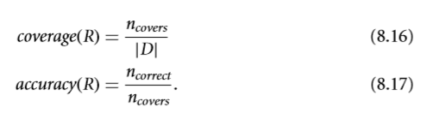
A rule R can be assessed by its coverage and accuracy.
Given a tuple, X, from a class labeled dataset, D.
Let n_{covers} be the number of tuples covered byR;
n_{correct} be the number of tuples correctly classiﬁed by R;
And |D|be the number of tuples in D.
We can deﬁne the coverage and accuracy of R as
A rule’ s coverage is the percentage of tuples that are covered by the rule (i.e., their attribute values hold true for the rule’s antecedent). For a rule’s accuracy, we look at the tuples that it covers and see what percentage of them the rule can correctly classify.

Slide 53
“How to use rule-based classiﬁcation to predict the class label of a given tuple, X?”
If a rule is satisﬁed by X, the rule is said to be triggered.
If R1 is the only rule satisﬁed, then the rule ﬁres by returning the class prediction for X.
If more than one rule is triggered, we need a conﬂict resolution strategy to ﬁgure out which rule gets to ﬁre and assign its class prediction to X.
There are many possible strategies. We look at two, namely size ordering and rule ordering.
The size ordering scheme assigns the highest priority to the triggering rule that has the “toughest” requirements, where toughness is measured by the rule antecedent size. That is, the triggering rule with the most attribute tests is ﬁred.
The rule ordering scheme prioritizes the rules beforehand. The ordering may be class-based or rule-based.

Slide 54
With class-based ordering, the classes are sorted in order of decreasing “importance” such as by decreasing order of prevalence (or frequency).
With rule-basedordering, the rules are organized into one long priority list, according to some measure of rule quality, such as accuracy, coverage, or size, or based on advice from domain experts. When rule ordering is used, the rule set is known as a decision list. With rule ordering, the triggering rule that appears earliest in the list has the highest priority, and so it gets to ﬁre its class prediction.
When there is no rule satisﬁed by X, a default rule can be set up to specify a default class, based on a training set.This may be the class in majority or the majority class of the tuples that were not covered by any rule. The default rule is evaluated at the end, if and only if no other rule covers X. The condition in the default rule is empty. In this way, the rule ﬁres when no other rule is satisﬁed.

Slide 55
8.4.2 Rule Extraction from a Decision Tree
To extract rules from a decision tree, one rule is created for each path from the root to a leaf node.
Each splitting criterion along a given path is logically ANDed to form the rule antecedent (“IF” part).
The leaf node holds the class prediction, forming the rule consequent (“THEN” part).

Slide 56
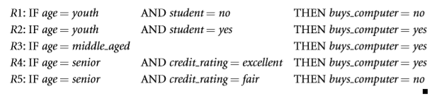
Example: The decision tree of Figure 8.2 can be converted to classiﬁcation IF-THEN rules by tracing the path from the root node to each leaf node in the tree. The rules extracted from Figure 8.2 are as follows:
A disjunction (logical OR) is implied between each of the extracted rules. All extracted rules are mutually exclusive and exhaustive.
Mutually exclusive means that we cannot have rule conﬂicts here because no two rules will be triggered for the same tuple.
Exhaustive means there is one rule for each possible attribute–value combination, so that this set of rules does not require a default rule.

Slide 57
8.4.3 Rule Induction Using a Sequential Covering Algorithm
IF-THEN rules can be extracted directly from the training data (i.e., without having to generate a decision tree ﬁrst) using a sequential covering algorithm.
There are many sequential covering algorithms. Popular variations include AQ, CN2, and the more recent RIPPER.
The general strategy is as follows:
Rules are learned one at a time.
Each time a rule is learned, the tuples covered by the rule are removed, and the process repeats on the remaining tuples.

Slide 58
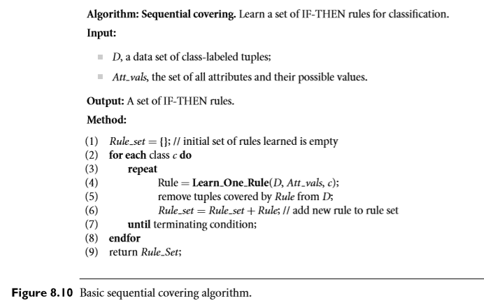

Slide 59

“How are rules learned?”
Suppose our training set, D, consists of loan application data. Attributes include age, income, education level, residence, credit rating, and the term of the loan. The classifying attribute is loan decision, which indicates whether a loan is accepted (considered safe) or rejected (considered risky). To learn a rule for the class “accept,” we start off with the most general rule possible, that is, the condition of the rule antecedent is empty. The rule is
We then consider each possible attribute test that may be added to the rule. These can be derived from the parameter Att vals, which contains a list of attributes with their associated values. For example, for an attribute–value pair (att, val), we can consider attribute tests such as att=val, att ≤val, att > val, and so on.

Slide 60
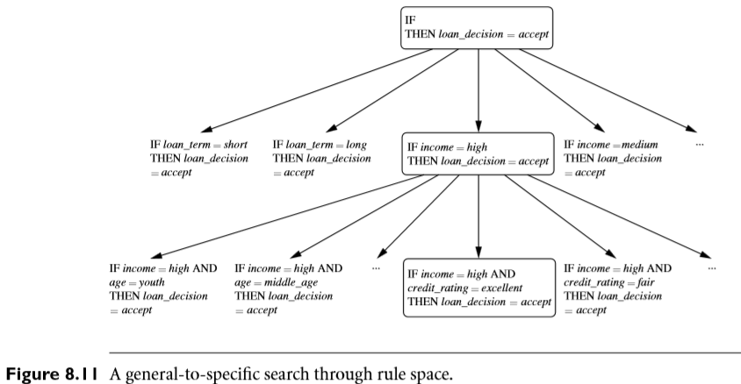

Slide 61
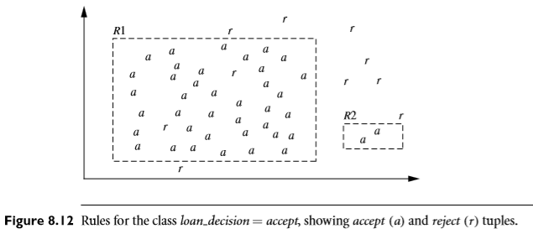
Rule Quality Measures
Rule R1 correctly classiﬁes 38 of the 40 tuples it covers. Rule R2 covers only two tuples, which it correctly classiﬁes. Their respective accuracies are 95% and 100%. Thus, R2 has greater accuracy than R1, but it is not the better rule because of its small coverage.
From that example, accuracy on its own is not a reliable estimate of rule quality. Coverage on its own is not useful either.

Slide 62
So now we will look at a few, namely entropy, another based on information gain, and a statistical test that considers coverage.
Our current rule is R: IF condition THEN class=c.
We call the new condition, condition', where R': IF condition' THEN class=c is our potential new rule. We want to see if R' is any better than R.
Entropy is also known as the expected information needed to classify a tuple in data set, D. Here,D is the set of tuples covered by condition' and p_{i} is the probability of class C_{i} in D. The lower the entropy, the better condition' is.

Slide 63

Another measure is based on information gain and was proposed in FOIL (First Order Inductive Learner).
In machine learning, the tuples of the class for which we are learning rules are called positive tuples, while the remaining tuples are negative.
Let pos (neg) be the number of positive (negative) tuples covered by R.
Let pos' (neg') be the number of positive (negative) tuples covered by R'.
FOIL assesses the information gained by extending condition' as

Slide 64

We can also use a statistical test of signiﬁcance to determine if the apparent effect of a rule is not attributed to chance but instead indicates a genuine correlation between attribute values and classes.
The test compares the observed distribution among classes of tuples covered by a rule with the expected distribution that would result if the rule made predictions at random.
We can use the likelihood ratiostatistic,
where m is the number of classes.
For tuples satisfying the rule, f_{i} is the observed frequency of each class i among the tuples. e_{i} is what we would expect the frequency of each class i to be if the rule made random predictions.

Slide 65

Rule Pruning
Because the rules will likely overﬁt the data, they may perform well on the training data, but less well on subsequent data.
To compensate for this, we can prune the rules.
A rule is pruned by removing a conjunct (attribute test).
We choose to prune a rule, R, if the pruned version of R has greater quality.
FOIL uses a simple yet effective method. Given a rule, R,
where pos and neg are the number of positive and negative tuples covered by R, respectively.

Slide 66
8.5 Model Evaluation and Selection
8.5.1 Metrics for Evaluating Classiﬁer Performance
This section presents measures for assessing how good or how “accurate” your classiﬁer is at predicting the class label of tuples.
The classiﬁer evaluation measures include accuracy (also known as recognition rate), sensitivity (or recall), speciﬁcity, precision, F₁, and Fβ.

Slide 67
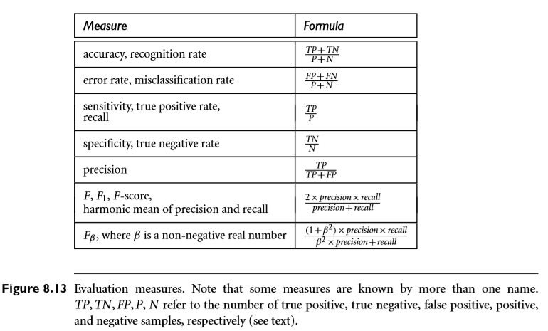

Slide 68
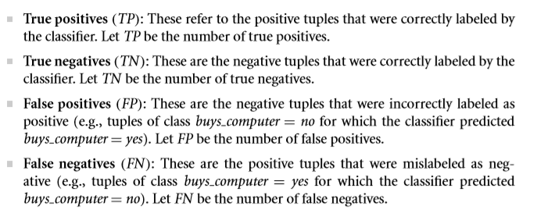

Slide 69
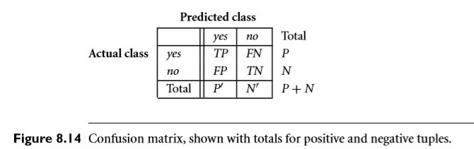
The confusion matrix is a useful tool for analyzing how well your classiﬁer can recognize tuples of different classes. TP and TN tell us when the classiﬁer is getting things right, while FP and FN tell us when the classiﬁer is getting things wrong (i.e.,mislabeling).

Slide 70
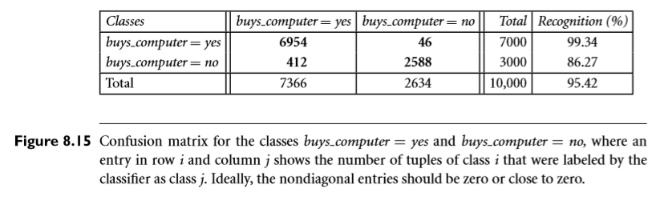

Slide 71


The accuracy ( or Recognition rate) of a classiﬁer on a given test set is the percentage of test set tuples that are correctly classiﬁed by the classiﬁer. That is,
We can also speak of the error rate or misclassiﬁcation rate of a classiﬁer, M, which is simply 1−accuracy(M), where accuracy(M) is the accuracy of M. This also can be computed as

Slide 72
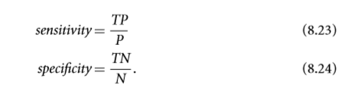
We now consider the class imbalance problem, where the data set distribution reﬂects a signiﬁcant majority of the negative class and a minority positive class.
→The sensitivity and speciﬁcity measures can be used, respectively, for this purpose.
Sensitivity is also referred to as the true positive (recognition) rate (i.e., the proportion of positive tuples that are correctly identiﬁed).
Speciﬁcity is the true negative rate (i.e., the proportion of negative tuples that are correctly identiﬁed).
These measures are deﬁned as

Slide 73
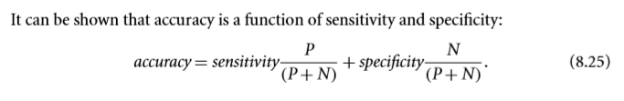
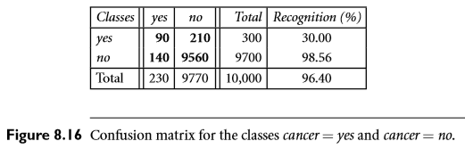

Slide 74
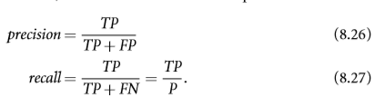
The precision and recall measures are also widely used in classiﬁcation.
Precision can be thought of as a measure of exactness (i.e., what percentage of tuples labeled as positive are actually such)
Recall is a measure of completeness (what percentage of positive tuples are labeled as such).

Slide 75
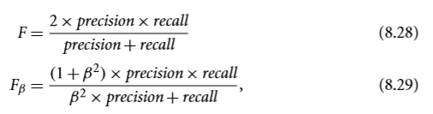
An alternative way to use precision and recall is to combine them into a single measure.
→ This is the approach of the F measure (also known as the F1 score or F-score) and the Fβ measure. They are deﬁned as
where β is a non-negative real number.
The F measure is the harmonic mean of precision and recall (the proof of which is left as an exercise).
The Fβ measure is a weighted measure of precision and recall. It assigns β times as much weight to recall as to precision. Commonly used Fβ measures are F₂ (which weights recall twice as much as precision) and F_{0.5} (which weights precision twice as much as recall).

Slide 76
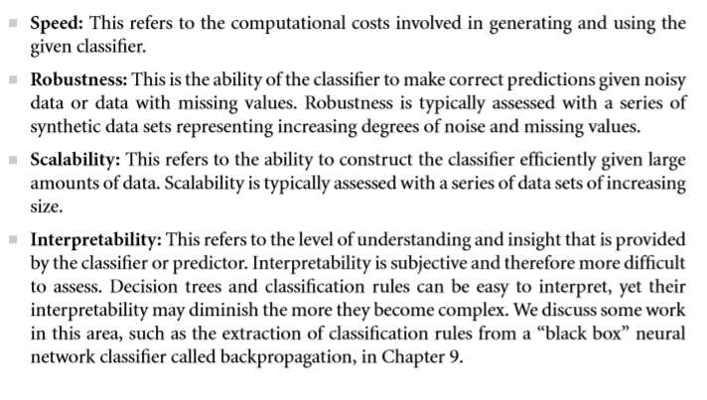
In addition to accuracy-based measures, classiﬁers can also be compared with respect to the following additional aspects:

Slide 77
The accuracy measure works best when the data classes are fairly evenly distributed.
Other measures, such as sensitivity (or recall ), speciﬁcity, precision, F, and Fβ, are better suited to theclassimbalance problem, where the main class of interest is rare.
The remaining subsections focus on obtaining reliable classiﬁer accuracy estimates.

Slide 78
8.5.2 Holdout Method and Random Subsampling
In holdout method, the given data are randomly partitioned into two independent sets, a training set and a test set. Typically, two-thirds of the data are allocated to the training set, and the remaining one-third is allocated to the test set. The training set is used to derive the model. The model’s accuracy is then estimated with the test set (Figure 8.17).
Random subsampling is a variation of the holdout method in which the holdout method is repeated k times. The overall accuracy estimate is taken as the average of the accuracies obtained from each iteration.

Slide 79
8.5.3 Cross-Validation
In k-fold cross-validation, the initial data are randomly partitioned into k mutually exclusive subsets or “folds,” D1, D2,..., Dk, each of approximately equal size. Training and testing is performed k times. In iteration i, partition Di is reserved as the test set, and the remaining partitions are collectively used to train the model.
Leave-one-out is a special case of k-fold cross-validation where k is set to the number of initial tuples.
In stratiﬁed cross-validation, the folds are stratiﬁed so that the class distribution of the tuples in each fold is approximately the same as that in the initial data.

Slide 80
8.5.4 Bootstrap
The bootstrap method samples the given training tuples uniformly with replacement. That is, each time a tuple is selected, it is equally likely to be selected again and re-added to the training set.
A commonly used one is the .632 bootstrap, which works as follows. Suppose we are given a data set of d tuples. The data set is sampled d times, with replacement, resulting in a bootstrap sample or training set of d samples. It is very likely that some of the original data tuples will occur more than once in this sample. The data tuples that did not make it into the training set end up forming the test set. Suppose we were to try this out several times. As it turns out, on average, 63.2%of the original data tuples will end up in the bootstrap sample, and the remaining 36.8% will form the test set (hence, the name, .632 bootstrap).

Slide 81
8.5.5 Model Selection Using Statistical Tests of Signiﬁcance
To determine if there is any “real” difference in the mean error rates of two models, we need to employ a test of statistical signiﬁcance. In data mining practice, we may often employ a single test set, that is, the same test set can be used for both M1 and M2. In such cases, we do a pairwise comparison of the two models for each 10-fold cross-validation round.
Let err(M1)_{i} (or err(M2)_{i}) be the error rate of model M1 (or M2) on round i.
The error rates for M1 are averaged to obtain a mean error rate for M1, denoted err(M1). Similarly, we can obtain err(M2).
The variance of the difference between the two models is denoted var(M1−M2).
The t-test computes the t-statistic with k−1 degrees of freedom for k samples.

Slide 82
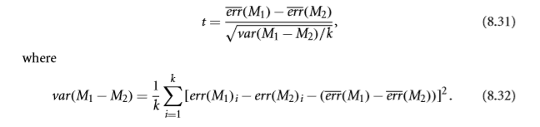

The t-statistic for pairwise comparison is computed as follows:
If two test sets are available instead of a single test set, then a non-paired version of the t-test is used, where the variance between the means of the two models is estimated as

Slide 83
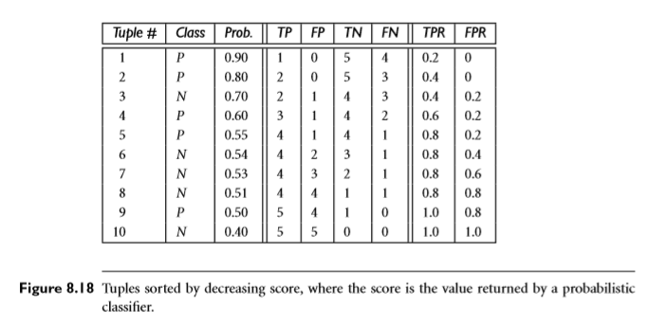
8.5.6 Comparing Classiﬁers Based on Cost–Beneﬁt and ROC Curves(Receiver operating characteristic curves)

Slide 84
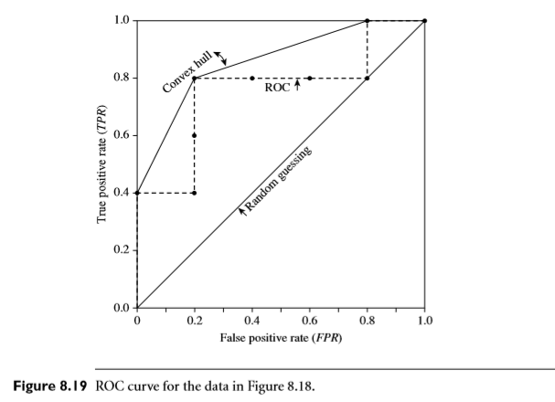

Slide 85
8.6 Techniques to Improve Classiﬁcation Accuracy
8.6.1 Introducing Ensemble Methods
Bagging, boosting, and random forests are examples of ensemble methods.
An ensemble combines a seriesof k learned models (or baseclassiﬁers), M1, M2,..., Mk, with the aim of creating an improved composite classiﬁcation model, M∗.
An ensemble tends to be more accurate than its base classiﬁers.

Slide 86
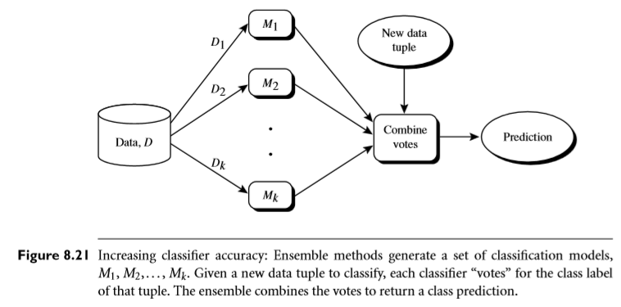

Slide 87
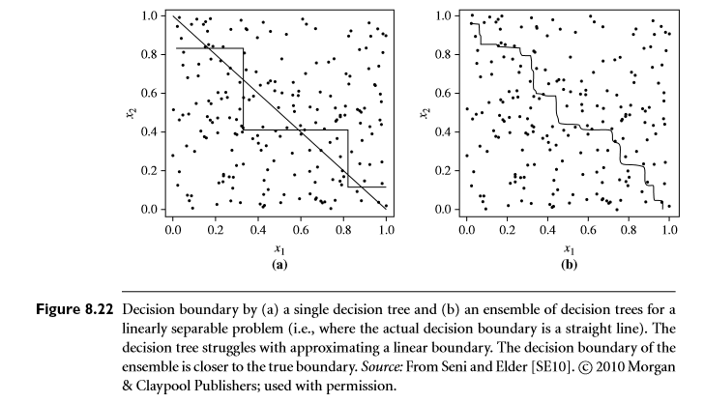

Slide 88
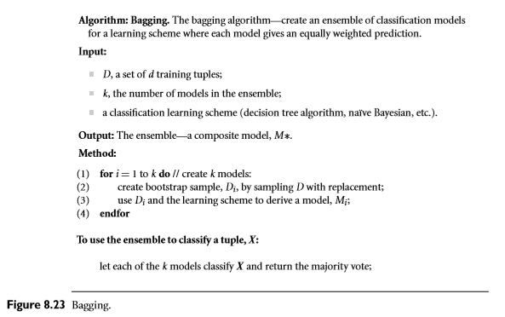
8.6.2 Bagging

Slide 89
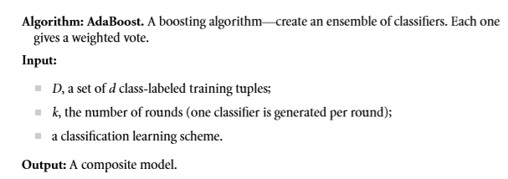
8.6.3 Boosting and AdaBoost
In boosting, weights are also assigned to each training tuple. A series of k classiﬁers is iteratively learned. After a classiﬁer, M_{i}, is learned, the weights are updated to allow the subsequent classiﬁer, M_{i}+1, to “pay more attention”to the training tuples that were misclassiﬁed by M_{i}. The ﬁnal boosted classiﬁer, M∗, combines the votes of each individual classiﬁer, where the weight of each classiﬁer’s vote is a function of its accuracy.
AdaBoost (short for Adaptive Boosting) is a popular boosting algorithm. Initially, AdaBoost assigns each training tuple an equal weight of 1/d. Generating k classiﬁers for the ensemble requires k rounds through the rest of the algorithm.

Slide 90
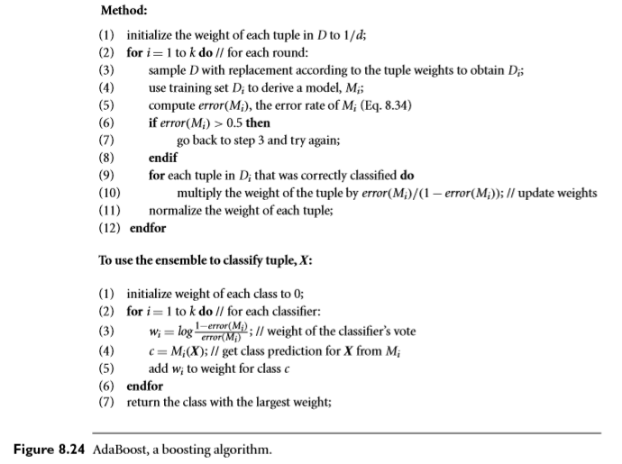

Slide 91
8.6.4 Random Forests
When using Random Forests, each of the classiﬁers in the ensemble is a decision tree classiﬁer so that the collection of classiﬁers is a “forest". The individual decision trees are generated using a random selection of attributes at each node to determine the split. During classiﬁcation, each tree votes and the most popular class is returned.
Random forests which is built using bagging in tandem with random attribute selection,and with random input selection, are called Forest-RI..
Another form of random forest, called Forest-RC, uses random linear combinations of the input attributes. Instead of randomly selecting a subset of the attributes, it creates new attributes (or features) that are a linear combination of the existing attributes.
→ Random forests are comparable in accuracy to AdaBoost, yet are more robust to errors and outliers. Because random forests consider many fewer attributes for each split, they are efﬁcient on very large databases. They can be faster than either bagging or boosting. Random forests give internal estimates of variable importance.

Slide 92
8.6.5 Improving Classiﬁcation Accuracy of Class-Imbalanced Data
The general approaches for improving the classiﬁcation accuracy of class-imbalanced data include (1) oversampling, (2) undersampling, (3) threshold moving, and (4) ensemble techniques.
The ﬁrst three do not involve any changes to the construction of the classiﬁcation model. For ease of explanation, we describe these general approaches with respect to the two-class imbalance data problem, where the higher-cost classes are rarer than the lower-cost classes.
Both oversampling and undersampling change the training data distribution so that the rare (positive) class is well represented.
Over sampling works by resampling the positive tuples so that the resulting training set contains an equal number of positive and negative tuples.
Undersampling works by decreasing the number of negative tuples.
The threshold-moving approach to the class imbalance problem does not involve any sampling. It applies to classiﬁers that, given an input tuple, return a continuous output value.

Slide 93
THE END
THANKS FOR LISTENING

